Slide 1
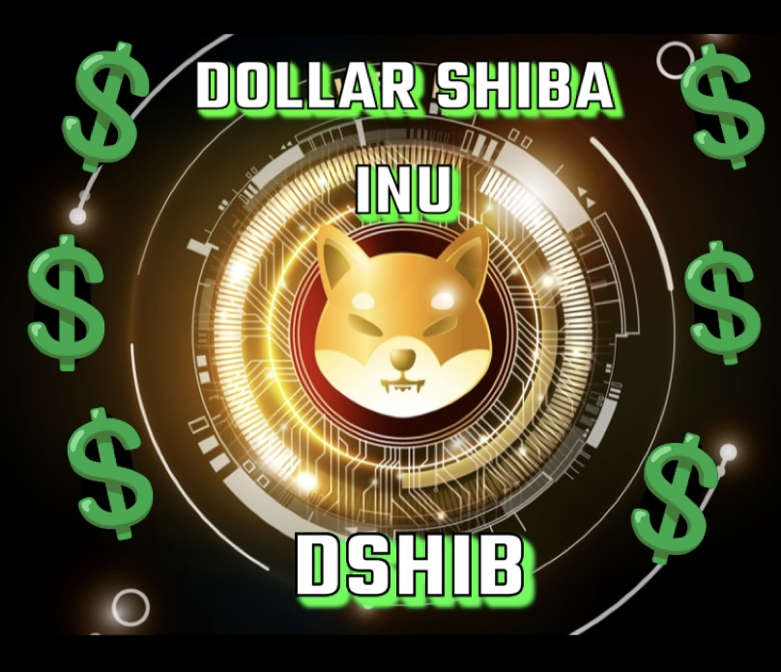
Dollar shiba inu
Whitepaper

Slide 2
Welcome to the Dshib Universe… .. ”We are changing the usefulness and purpose of a token to apply it in the creation of a better world and future”….
Honestly and sustainably improving the quality of life of people and our environment are concepts and terms that we hear daily. Until now they have rarely been paired with the crypto universe and with a given token.
With the creation of Dshib, the doubts of using a Token to improve the world disappear. ... "At the core of Dshib is the goal of living and collaborating to create a better planet" ...

Slide 3
Introduction
Token:
➢ A token is "a unit of value that an organization creates to govern its business model and empower its users to interact with its products, while facilitating the distribution and sharing of benefits among all its shareholders.“
➢ A 'token' (such as those used in arcade machines or bumper cars) is called a unit of value based on cryptography and issued by a private entity on a blockchain, such as Bitcoin or Ethereum. Bitcoins are 'tokens', but 'tokens' are not only cryptocurrencies but they can have many more uses.
Uses of a Token:
➢ Within a private network, a 'token' can be used to grant a right, to pay for a job or to transfer data, as an incentive, as a gateway to extra services or a better user experience.
➢ A 'token' will be used for what the person or organization that designs and develops it decides. The 'tokens' admit several layers of value within them, so it is whoever designs them who decides what a specific 'token' has inside ”.
➢ Is a token and a cryptocurrency the same?

Slide 4
Kick-Off
DShib begins shipping on April 2, 2023.
After several years of experience trading digital assets, a group of collaborators got down to work and decided to create a token: DShib, which not only allows investors to generate returns, but with each transaction that is generated, part is destined to conserve , improve and restore the world we live in.
The DShib project is made up of a large multidisciplinary and international team of developers, managers, designers, influencers, collaborators and partners
Each member of the team has extensive experience in each area, allowing us to continue expanding profits and developing improvements.
DShib is a project in continuous development and growth. This allows us to measure the impact of each initiative and adapt to the current situation and trend of the crypto markets.
At DShib we believe that good training and education is essential to face the future that is to come. For this reason, one of the phases of the project involves training and training people and companies in the use of cryptocurrencies and in the adoption of technology.

Slide 5



Tokens purchase/Sales & operative
Investors can acquire the tokens in the following contract:
https://bscscan.com/token/0x3ab414b56590a5376f5bd18a57f5680736be4d98#balances
2%
of each transaction will be automatically token burned.
Transactions Purchases & Sales
of each transaction will be automatically allocated into your liquidity wallet.
2%
4%
of each transaction will go towards Marketing and Donations.

Slide 6

Global Supply and Burn
Burn Wallet
https://bscscan.com/token/0x3ab414b56590a5376f5bd18a57f5680736be4d98?a=0x000000000000000000000000000000000000dead
Global Supply
1 000 000 000 000 000 000 000

Slide 7

Certified audits
DShib has been audited by Audit Ace
One of the premises of the project is to provide confidence and security to our investors. In addition to ensuring that we are a reliable project and token.
Audits of processes and services are carried out periodically
You can check the result of each audit carried out in the following links:

Slide 8
Roadmap
Sprint 1:
➢ Launched Website √
➢ New Token Contract √
➢ Pancakeswap Launch √
➢ Certified Audits √
➢ Whitepaper √
➢ Marketing √
Sprint 2:
➢ Listed on Coingecko
➢ Listed on CoinMarketcap
➢ +5.000 Holders
➢ +15000 Twitter Followers
Sprint 3:
➢ +15.000 Holders
➢ Web 3.0
Sprint 4:
➢ 1st Donation
➢ +30.000 Holders
➢ DShibVerse Launch
➢ +50.000 Twitter Followers
➢ Certik Certified Audit
Sprint 5:
➢ CEX Launch
➢ New NFT collection
➢ +100.000 Holders
➢ DShib Pay

Slide 9
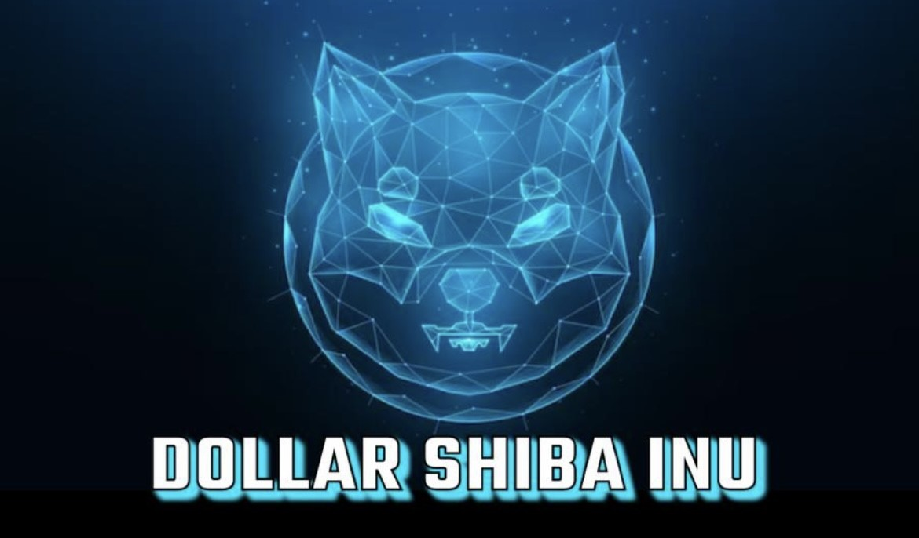
One of the milestones that we have proposed to achieve by 2023 is to create the “DShibVerse” Universe.
DShibVerse will be a web game using NFT.
In DShibVerse you can reduce the carbon footprint of a province that you manage within the global map created. The data for the
game provinces and the global world will be based on real world data.
The game will have a variety of options to improve your carbon footprint, such as planting more trees, using green energy and
reducing CO2 emissions, helping to reduce and combat global warming.
DshibVerse is in beta phase, we will advance news soon.
… ”Help the #Metaverse and the real world simultaneously #DShibArmy”…

Slide 10



https://twitter.com/DShiba_token
https://t.me/Dshib_token
https://dollarshib.com

Slide 11
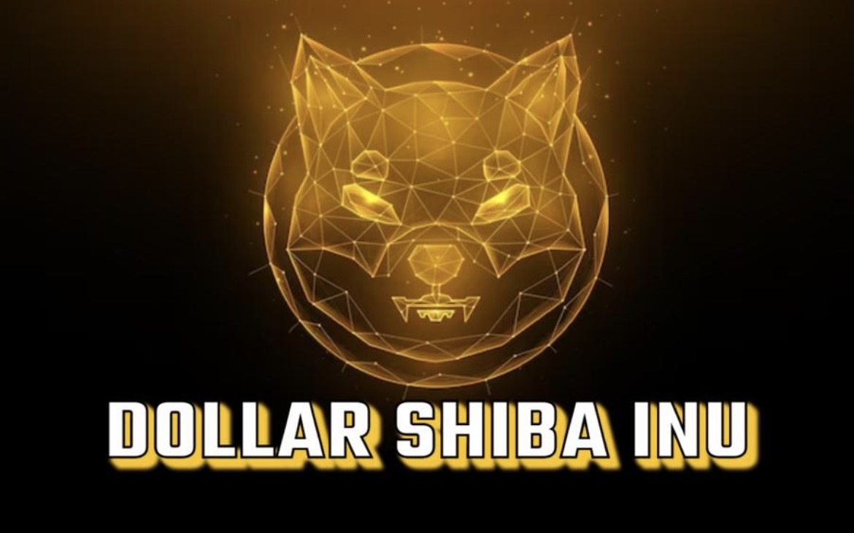
Thank you for your confidence !
DOLLAR SHIBA INU 2023

